Slide 1
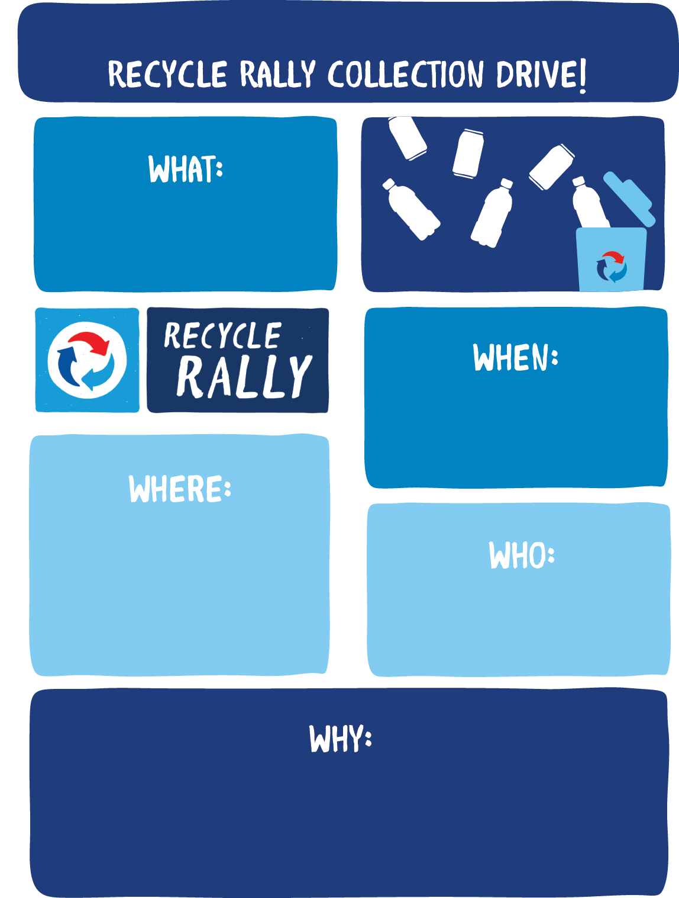
[ENTER SCHOOL YEAR]
Recycle Rally Collection Drive!
[INSERT DATE
AND TIME]
[INSERT ROOM OR LOCATION]
[i.e. gym, cafeteria, classroom]
[INSERT SCHOOL OR GROUP NAME]
students and staff
Recycle your aluminum cans and plastic bottles* at [INSERT SCHOOL]’s
Recycling Collection Drive and help us help the environment!
*Plastic #1 (PETE) beverage bottles

