Slide 2
Recycling Game Instructions
Select Team players: Evenly divide students into 5 teams. Students should be sitting in a group in order to consult on the correct answers. The first team to quietly get themselves in a small group, will play first.
Begin Game by putting the file in “Presentation Mode.”
Start game by clicking a number on the score board to be directed to the first question. A question will appear to ask the first team. Set a timer for each question (allow either 30 seconds or 1 minute to discuss and answer the question).
Once the team has answered, click the question one more time for the official answer to appear.
If the team answered correctly, the number of points selected on the score board will be given to that team.
Click on the white arrow on the bottom of the screen to jump back to the score board for the game to continue.
* Some questions have a chance for a bonus question. Click on the bonus box if it appears to be directed to the bonus question. Each bonus question will open up the opportunity to all teams to answer additional questions for 10 points each.

Slide 3
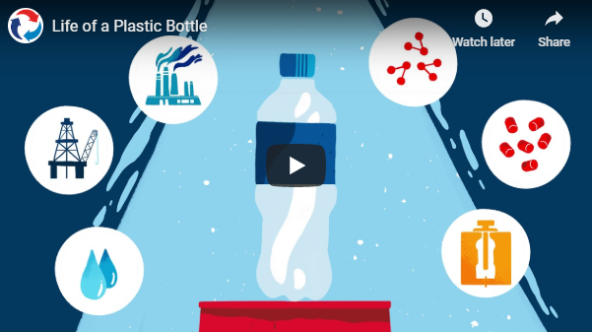
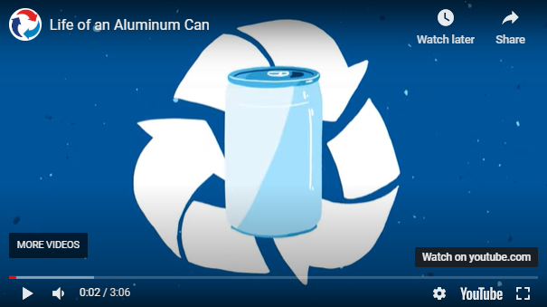
Before playing the game, we recommend you show your students these videos so they can obtain the knowledge needed to answer some of the questions.
Life of a Plastic Bottle
Click here to play the video.
Life of an Aluminum Can
Click here to play the video.

Slide 4

10
10
10
10
10
20
20
20
20
20
30
30
30
30
30
40
40
40
40
40
50
50
50
50
50

Slide 5
‘IS IT RECYCLABLE’ FOR 10 POINTS
Question:
Can you recycle a plastic bottle
with “#1 PETE” embossed on it?
Answer:
Yes!

Slide 6
‘IS IT RECYCLABLE’ FOR 20 POINTS
Question:
Can you recycle a “slim” (7.5 oz or 8 oz) aluminum can?
Answer:
Yes!

Slide 7
‘IS IT RECYCLABLE’ FOR 30 POINTS
Question:
Can you recycle steel?
Answer:
Yes!
Steel cans are generally accepted through most curbside recycling programs. Pots and pans and other types of steel are often accepted too and if not they can usually be recycled through scrap metal companies.

Slide 8
‘IS IT RECYCLABLE’ FOR 40 POINTS
Question:
Can you recycle a used mobile phone or electronic tablet?
Answer:
Yes!
Most electronics, such as mobile phones and tablets, are recyclable through a local electronic waste program. Contact your local recycling program or electronics retailers to find out where you can take old electronics.

Slide 9
‘IS IT RECYCLABLE’ FOR 50 POINTS
Question:
Name 6 Different Items That Are Recyclable
Answer:
Click through to the Bonus Question to reveal possible answers!
Bonus Question!

Slide 10
‘HOW TO RECYCLE’ FOR 10 POINTS
Question:
How do you know if a plastic object is recyclable?
Answer:
Look for a recycling symbol on the bottom. If you see one, then make sure your local recycling hauler accepts that type of plastic.

Slide 11
‘HOW TO RECYCLE’ FOR 20 POINTS
Question:
True or False?: You drank a couple sips out of a bottle but don’t want to finish it. It’s fine to throw it into the recycling bin without dumping the liquid out first.
Answer:
False! Always make sure liquids have been poured out! If a lot of liquid is left in bottles or containers, it will contaminate the other materials. Excess liquids can make materials like paper soggy and unable to be recycled.

Slide 12
‘HOW TO RECYCLE’ FOR 30 POINTS
Question:
True or False?: You do not need to crush aluminum cans before putting them in a recycling bin
Answer:
True, the automatic sorting equipment may have an easier time separating them from other materials if cans are not crushed.

Slide 13
‘HOW TO RECYCLE’ FOR 40 POINTS
Question:
What are the three steps to recycling a material?
Answer:
Check (to make sure it’s recyclable)
Empty (to eliminate contaminants)
Recycle – place it in a recycling bin or drop it off at a recycling center

Slide 14
‘HOW TO RECYCLE’ FOR 50 POINTS
Question:
Name at least 4 different places where you can find a recycling bin
Answer:
Click through to the Bonus Question to reveal possible answers!
Bonus Question!
Notes:
Possible answers: home, playground, gym, school office, library, local park, movie theater, local recreation center

Slide 15
‘THE RECYCLING PROCESS’ FOR 10 POINTS
Question:
After recyclables are picked up from your school, where do they go next?
Answer:
The Materials Recovery Facility (MRF)
Other acceptable answers depending on specificity and local infrastructure: Truck (front-end loader, box truck, etc.), Recycling Center, Transfer Station.

Slide 16
‘THE RECYCLING PROCESS’ FOR 20 POINTS
Question:
True or False?: Once plastic bottles are separated from other materials at a Materials Recovery Facility, they don’t need to be cleaned or processed in any other way before being made into new bottles.
Answer:
False. The material must be chopped into flakes, thoroughly washed, cleaned, dried, and converted into resin pellets before being ready to become a new bottle.

Slide 17
‘THE RECYCLING PROCESS’ FOR 30 POINTS
Question:
After being separated from other materials, large amounts of each type of recyclable are typically compacted into a _______?
a. Pack b. Bale
c. Super Sack d. Bunch
Answer:
b. Bale

Slide 18
‘THE RECYCLING PROCESS’ FOR 40 POINTS
Question:
At the Materials Recovery facility, aluminum cans are separated from other materials using a _________.
a. Tommy Current b. Freddy Current
c. Eddy Current d. Magnetic Current
Answer:
b. Eddy Current

Slide 19
‘THE RECYCLING PROCESS’ FOR 50 POINTS
Question:
Name three different technologies or techniques that Material Recovery Facilities (or MRFs) use to separate various types of recyclable materials from each other.
Answer:
Click through to the Bonus Question to reveal possible answers!
Bonus Question!
Notes:
Possible answers: magnets, varying speeds, float/sink processes, air blows, gaps between conveyors, screens, eddy currents, visual inspections, etc.

Slide 20
‘PLASTIC OR ALUMIUM’ FOR 10 POINTS
Question:
The virgin form of this material is made using petroleum (oil) and natural gas.
Note: “virgin” means made from raw materials, not recycled materials
Answer:
Plastic

Slide 21
‘PLASTIC OR ALUMIUM’ FOR 20 POINTS
Question:
This material is made from digging the mineral Bauxite from underground.
Answer:
Aluminum

Slide 22
‘PLASTIC OR ALUMIUM’ FOR 30 POINTS
Question:
When not turned back into beverage containers, this material is often recycled into carpets or clothing.
Answer:
Plastic

Slide 23
‘PLASTIC OR ALUMIUM’ FOR 40 POINTS
Question:
The recycling process can happen so quickly for this material that it can be back on the shelf as a new beverage container within as little as 60 days after you drop it in a recycling bin.
Answer:
Aluminum
Source: The Aluminum Association

Slide 24
‘PLASTIC OR ALUMIUM’ FOR 50 POINTS
Question:
What type of material can be identified by a recycling symbol with the number 9 inside of it?
Answer:
Neither! While you can find a recycling symbol with a number inside on plastic containers, they only go from #1 - #7.
Bonus Question!

Slide 25
‘RECYCLING FACTS’ FOR 10 POINTS
Question:
Recycled aluminum cans can be made into which of the following?
a. Airplane b. Bicycle
c. Aluminum Can d. All of the above
Answer:
d. All of the above

Slide 26
‘RECYCLING FACTS’ FOR 20 POINTS
Question:
Out of every 10 bottles and cans consumed in the U.S., about how many of them are recycled?
a) 1 b) 3
c) 4 d) 8
Answer:
c) 4
Source: American Beverage Association (ABA)

Slide 27
‘RECYCLING FACTS’ FOR 30 POINTS
Question:
What does it mean to “Close the Loop?”
Answer:
Recycle an item so its useful life can continue instead of ending its life by discarding it into a landfill or burning it. Instead of going in a straight line (from start to finish) the lifecycle goes in a circle, or loop, (from start to used to start again).

Slide 28
‘RECYCLING FACTS’ FOR 40 POINTS
Question:
Of the following materials, which one has the highest recycling rate?
a. Aluminum b. Electronics (cell phones, computers, etc.)
c. Car Tires d. Plastic #1 PETE bottles
Answer:
a. Aluminum

Slide 29
‘RECYCLING FACTS’ FOR 50 POINTS
Question:
List at least 3 reasons why you should recycle.
Answer:
Click through to the Bonus Question to reveal possible answers!
Bonus Round!

Slide 30
‘IS IT RECYCLABLE’
Bonus Question!
Each person who can name one additional recyclable material will earn 10 points for his/her team!
Possible Answers:
plastic beverage bottles, milk jugs, milk cartons, yogurt containers, plastic cleaning supply bottles, plastic jugs, glass bottles, glass jars, aluminum cans, steel cans, cardboard boxes, cereal boxes, newspaper, office paper, etc.

Slide 31
‘HOW TO RECYCLE’
Bonus Question!
Each person who can name an additional place to recycle will earn 10 points for his/her team!
Possible Answers:
Home, playground, gym, school office, library, local park, movie theater, local recreation center

Slide 32
‘THE RECYCLING PROCESS’
Bonus Question!
Each person who can name an additional technology or technique that Material Recovery Facilities (or MRFs) use to separate various types of recyclable materials will earn 10 points for his/her team!
Possible Answers:
Magnets, varying speeds, float/sink processes, air blows, gaps between conveyors, screens, eddy currents, visual inspections, etc.

Slide 33
Bonus Question!
Match the recycling symbols on the left to the type of plastic on the right
Start with a team that did not have an opportunity to answer the 50 point question in this category. Begin by identifying an answer for #1 and if the answer is correct, proceed to #2. If the answer is incorrect, allow the next team to attempt the same # and continue to do so until the correct answer is determined.
#1 PVC
#2 PETE or PET
#3 PP
#4 HDPE
#5 PS
#6 OTHER
#7 LDPE

Slide 34
RECYCLING FACTS’
Bonus Question!
Each person who can name an additional reason to recycle will earn 10 points for their team!
Possible Answers:
Possible answers: Preserve natural resources, better use of land, prevent pollution, emit fewer greenhouse gases, use less energy in the manufacturing process, enhance national security, support economic/job growth, etc.

