Slide 2
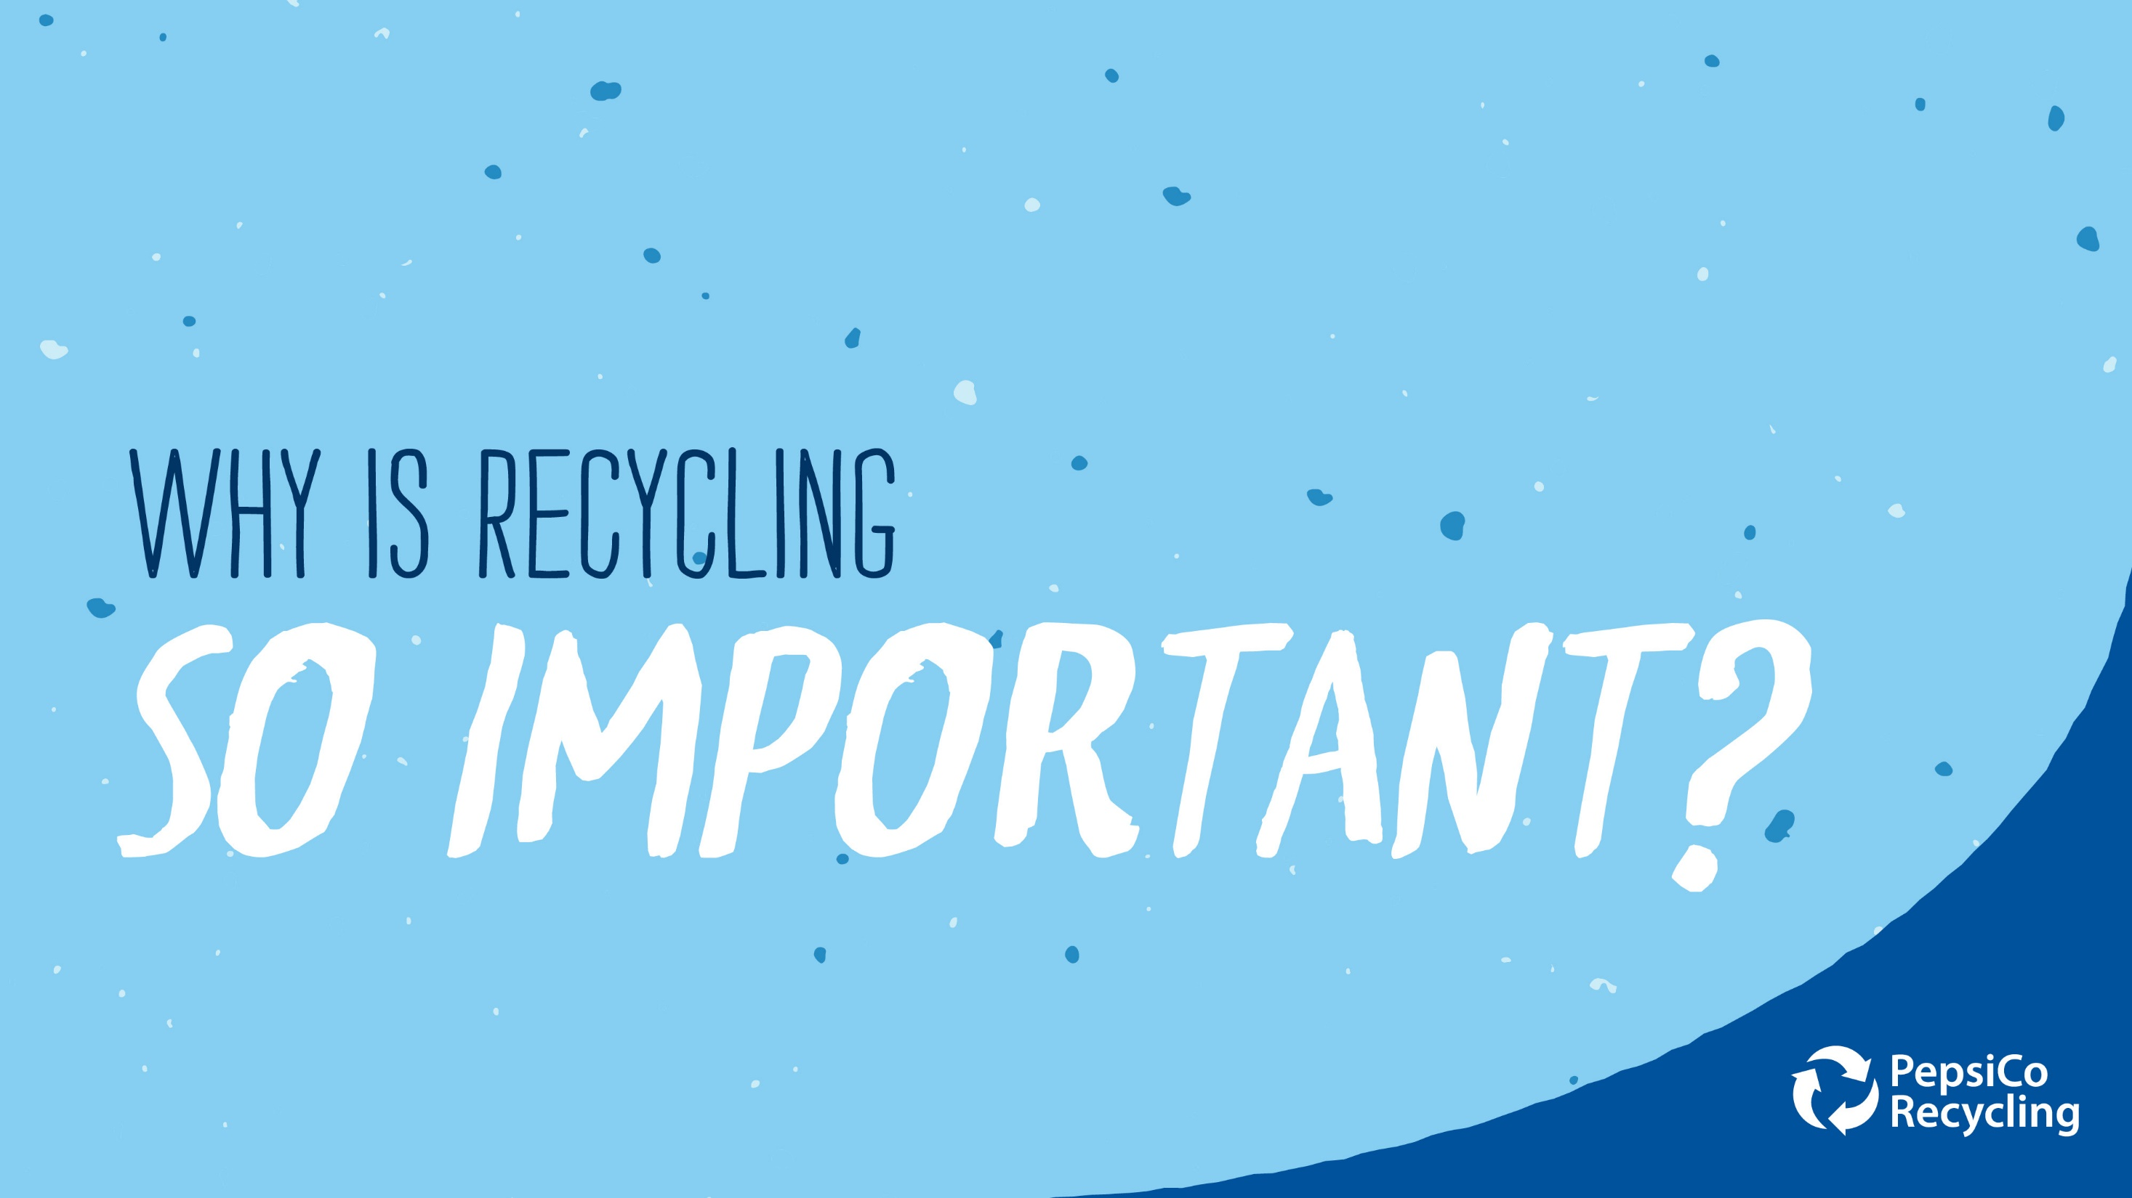
Notes:
You hear the word “recycle” over and over again, but why is recycling so important?

Slide 3
Notes:
If you recycle, you’re making a positive impact on the environment around you. Whenever you are able to recycle something, you are preventing a material from going to the landfill and making the landfill bigger. And no one wants landfills to keep growing!

Slide 4
Notes:
Creating brand new products like aluminum cans or plastic bottles uses valuable resources such as water, oil, natural gas and energy. By recycling, you are able to save each of those resources.

Slide 5
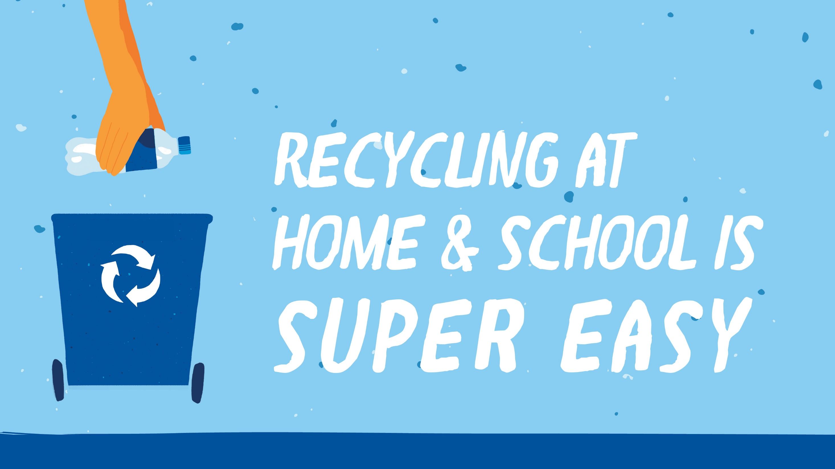
Notes:
Recycling at school and at home is super easy! Before you start recycling, talk to your parents and teachers about what is recyclable. Every recycling program in the country is different, so checking with what is accepted in your city or town is very important.
Once you know what is allowed in your recycling program, get started!

Slide 6
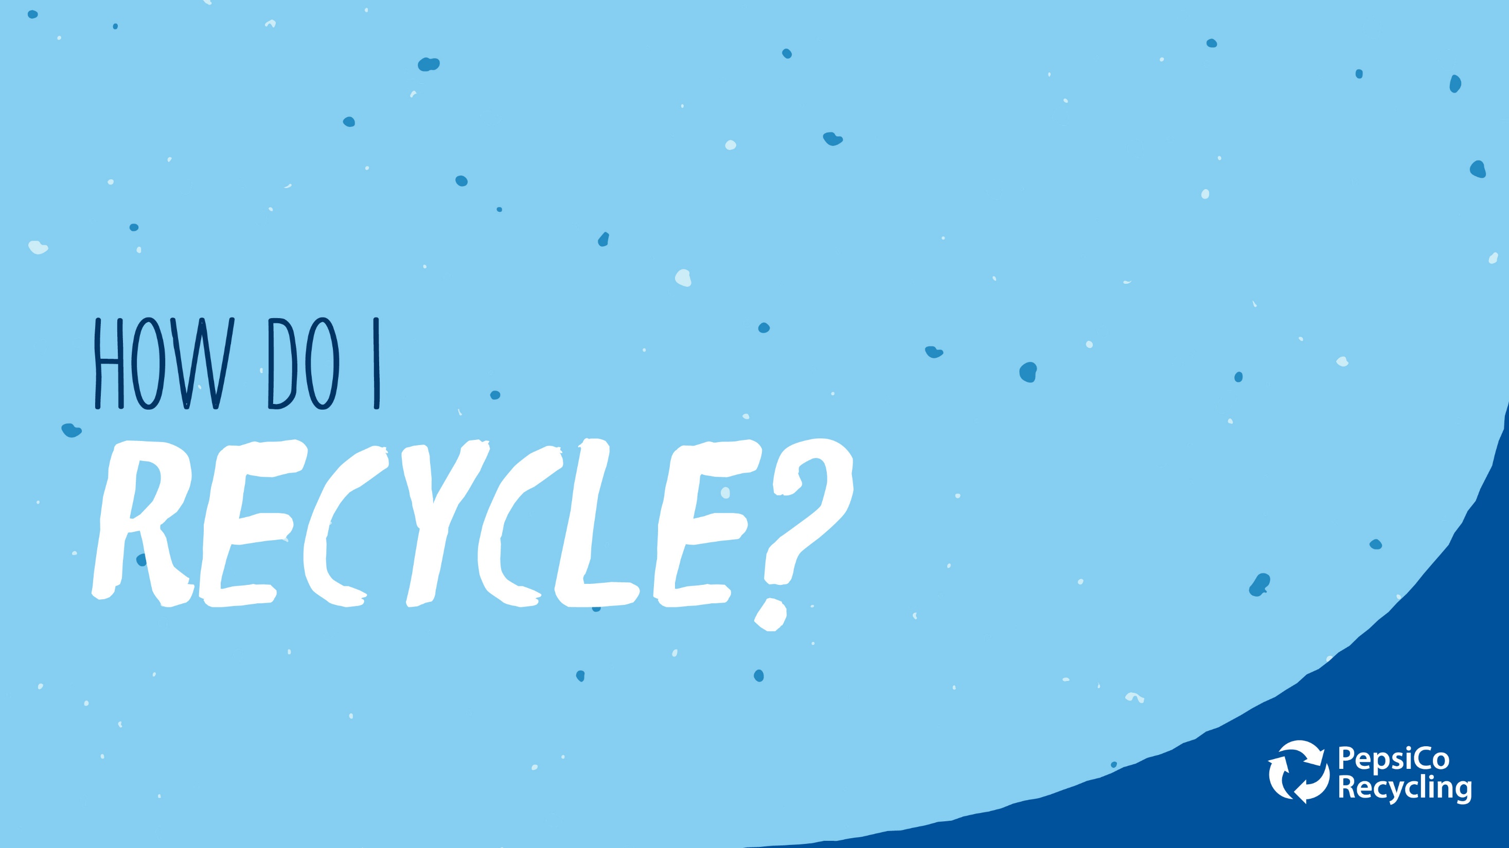
Notes:
So, what should you do to recycle at home or at school?

Slide 7
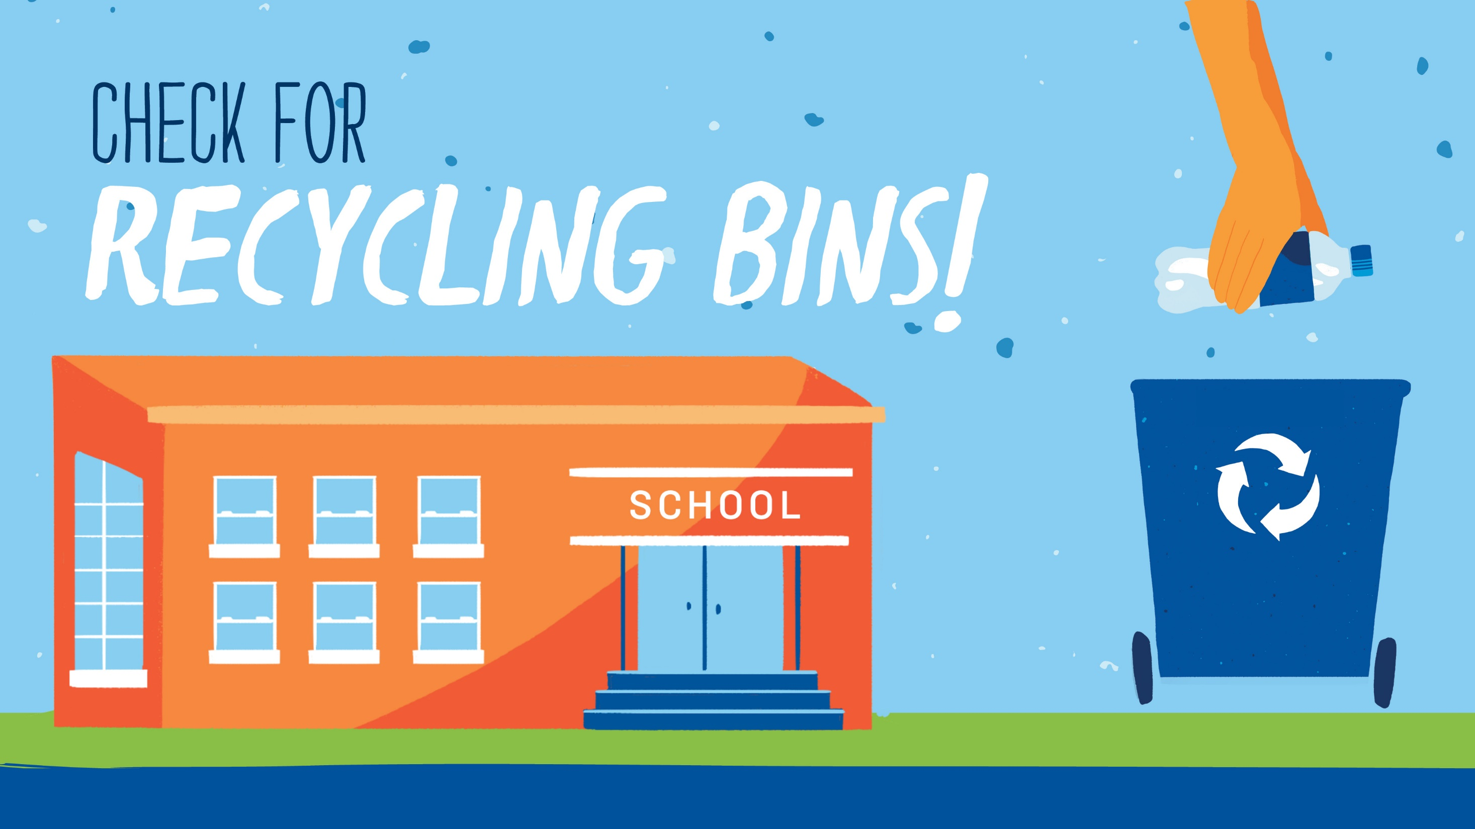
Notes:
From the time you walk into school, make sure you check for where and what bins are available that way you know where to drop your recyclables in the next time you have an opportunity.

Slide 8
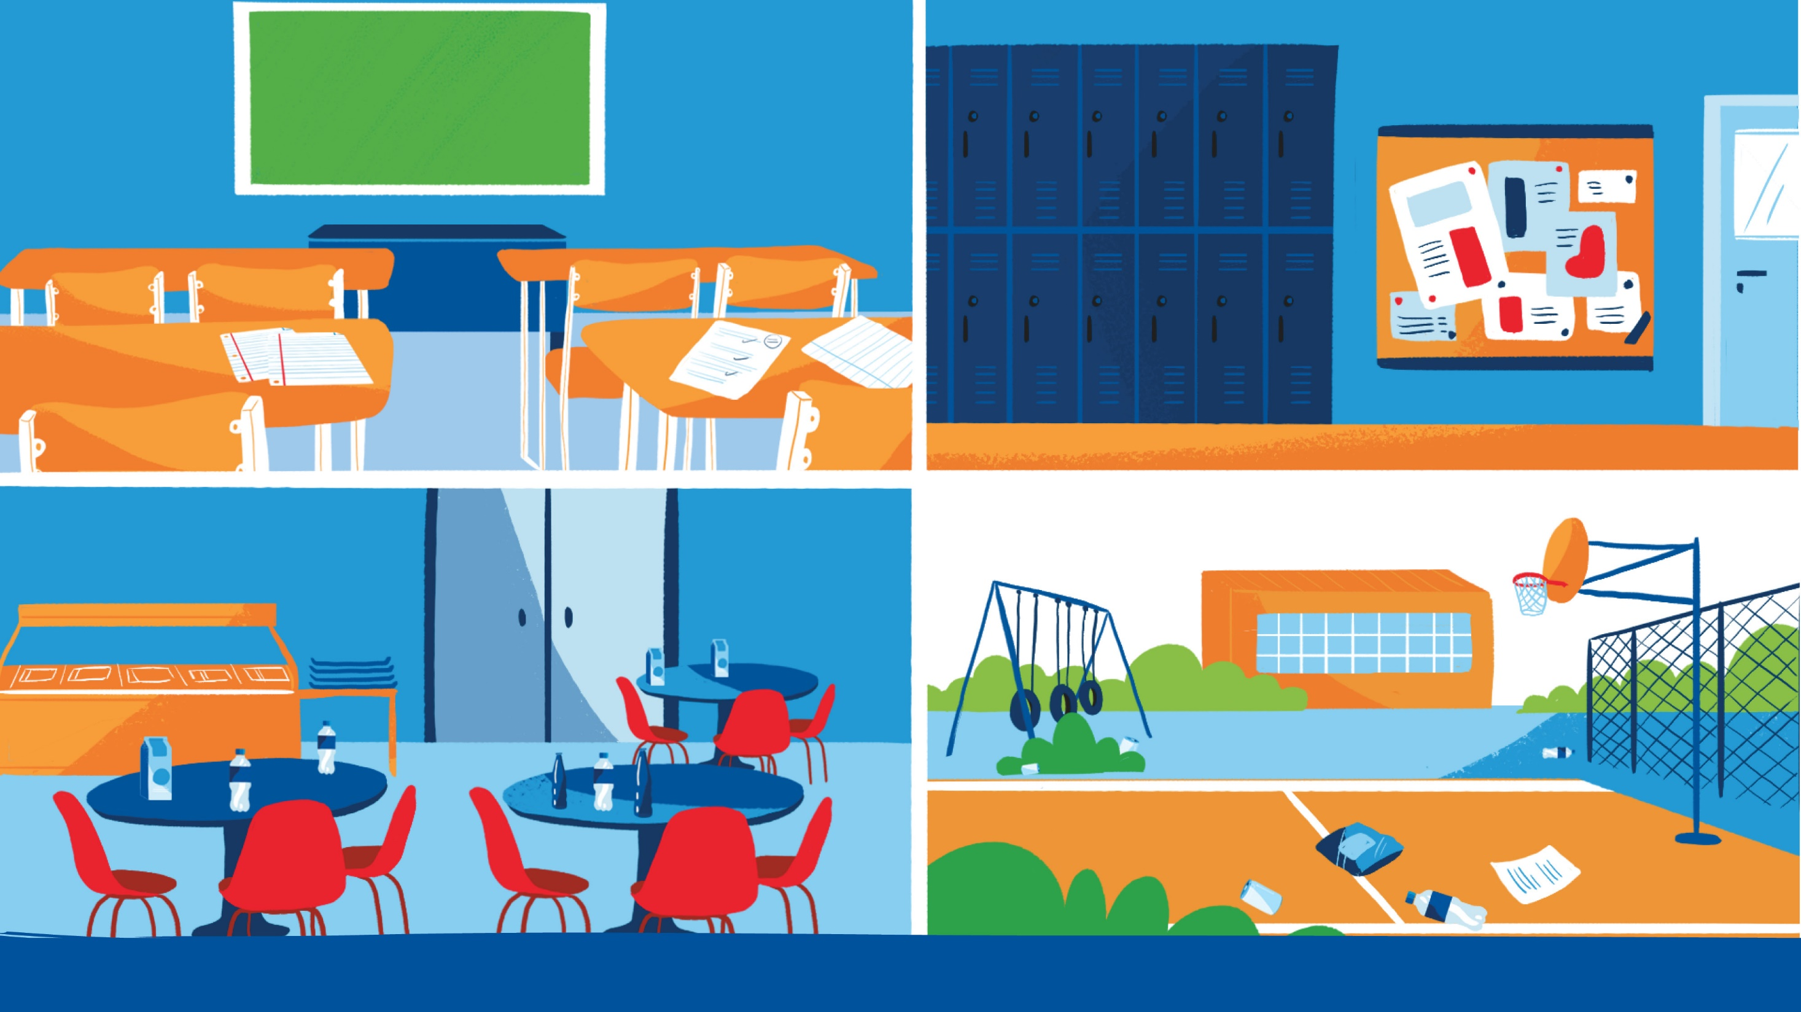
Notes:
Think about what is recyclable around you? What about that paper from class or aluminum can from the cafeteria?
Recycling can be done throughout the day, whether you are at home, in the classroom, cafeteria or find some recyclables left out on the playground or soccer field. Do your part and recycle!

Slide 9
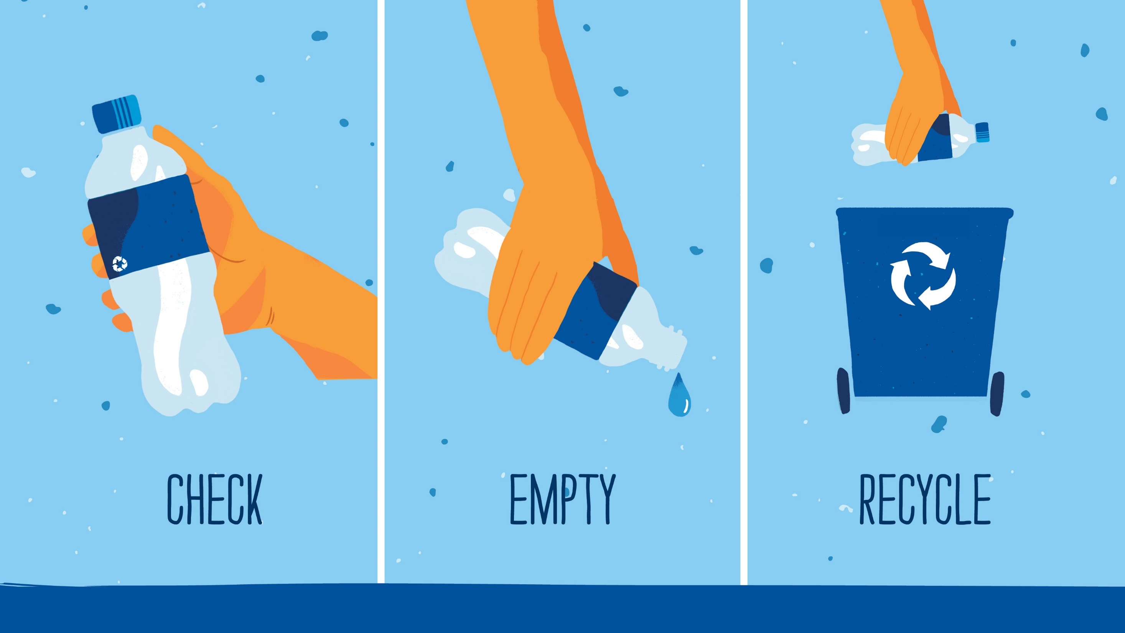
Notes:
Recycling is easy. Whatever the material you have:
#1- Check to make sure it is recyclable.
#2- Clean it out or pour out any liquids
#3- Place it in the correct recycling bin.
That’s It!

Slide 10
Notes:
Did you know?
By recycling just 6 plastic bottles you could help make a new t-shirt, wow! (Repreve: https://www.wastewiseproductsinc.com/blog/programs-initatives/recycling-plastic-bottles-into-clothing-with-repreve/)
If you recycle just one ton of paper, you will save about 17 trees! (EPA: https://archive.epa.gov/epawaste/conserve/smm/wastewise/web/html/factoid.html)
Recycling just one aluminum can saves enough energy to power a TV for 3 hours! (The Aluminum Association)

Slide 11
Notes:
What happens to an aluminum can or plastic bottle from the time you put it in a recycling bin until they are made into new materials and put back on the shelf?

Slide 12
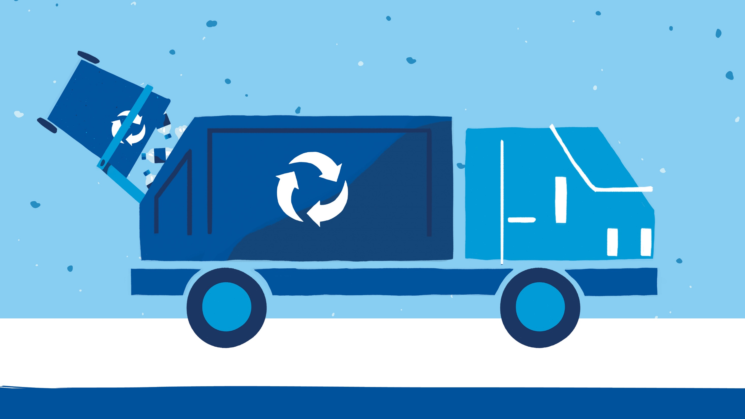
Notes:
The recycling process starts as soon as you place your material in a bin. That bin is then picked up by a recycling truck.

Slide 13
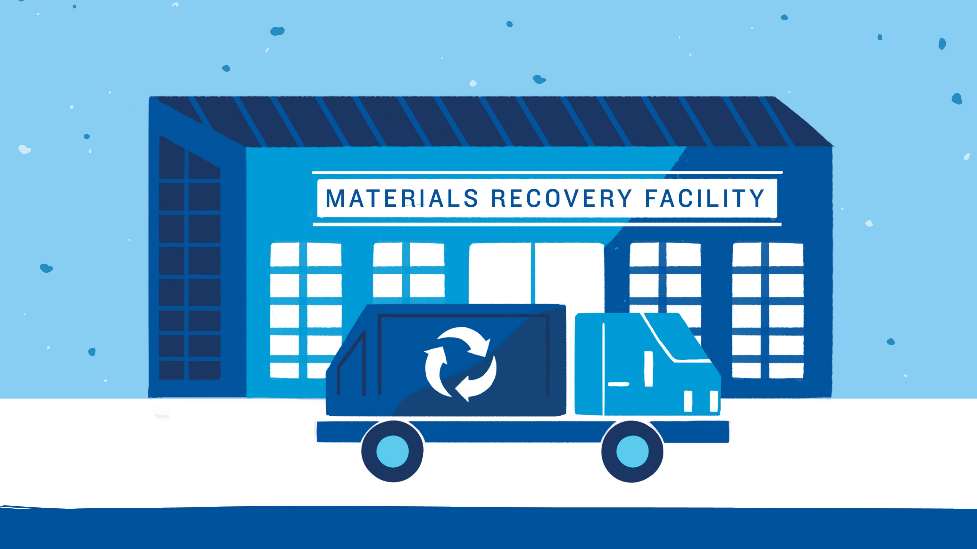
Notes:
A recycling truck will dump each of the loads it brings onto the floor of a facility, called a MRF or Materials Recovery Facility.

Slide 14
Notes:
At the MRF, materials are placed on a conveyor belt where they are transported all across the facility based on the type of material it is. The MRF equipment and people hand sorting, will sort each of the materials based on their shape, density, and other properties

Slide 15
Notes:
Paper will go over a conveyor with a series disk screens. They allow for containers and larger objects to fall through the screens and the paper to keep moving on the conveyor.

Slide 16
Notes:
Next, all those containers that fell are sorted by plastics or metal or other types. Steel and tin cans are magnetically picked up and sorted, plastics are picked out separately and glass tends to fall through to be collected at the floor.

Slide 17
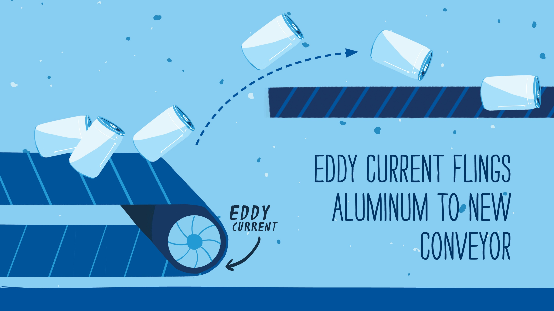
Notes:
Since aluminum cans are not magnetic, they are left behind from the other cans and a machine called an eddy current flings the aluminum cans to a new line to be sorted.
An eddy current is a series of multiple magnets or an electromagnet spinning at a high speed, which creates a special electromagnetic field, pushing the aluminum cans over a barrier into their own dedicated section.
Think about how if you hold two similar sides of a magnet together, the force pushes them apart. The eddy current creates a similar force using current.

Slide 18
Notes:
Once all materials have been sorted into categories, each material is baled which means a machine will take all of the materials in one category and crush them into one giant box-shaped object. Bales allow for each of the materials to be transported.

Slide 19
Notes:
Each material will go to specific processors to be washed, melted down and processed into a new form so it can be made into a new product again.
Did you know it only takes approximately 60 days from the time an aluminum can is recycled until it is back on the shelves as a new can?

Slide 20
Notes:
Recycling is an important piece of closing the loop. Think about how every time you pick up an plastic bottle, you’ll drink it, and dispose of it. If you put it in the trash, the cycle ends and a brand new bottle will have to be produced. However, if you recycle it, the cycle keeps going (Recycle >MRF>Processor>New Bottle) which saves resources and closes the loop.

Slide 21
Notes:
Once a material is recycled, there are endless possibilities as to what it can become!

Slide 22
Notes:
Plastic bottles- once recycled, are shredded into flakes, washed and melted into tiny pellets, called resin
Those resin pellets can become all sorts of new products, from t-shirts to soccer balls to playground equipment, carpet, and even new plastic bottles!

Slide 23
Notes:
Aluminum cans are very similar- once recycled, the aluminum is melted down and molded into the desired shapes.
Aluminum cans can become airplane parts, bicycles, and of course, brand new aluminum cans.

Slide 24
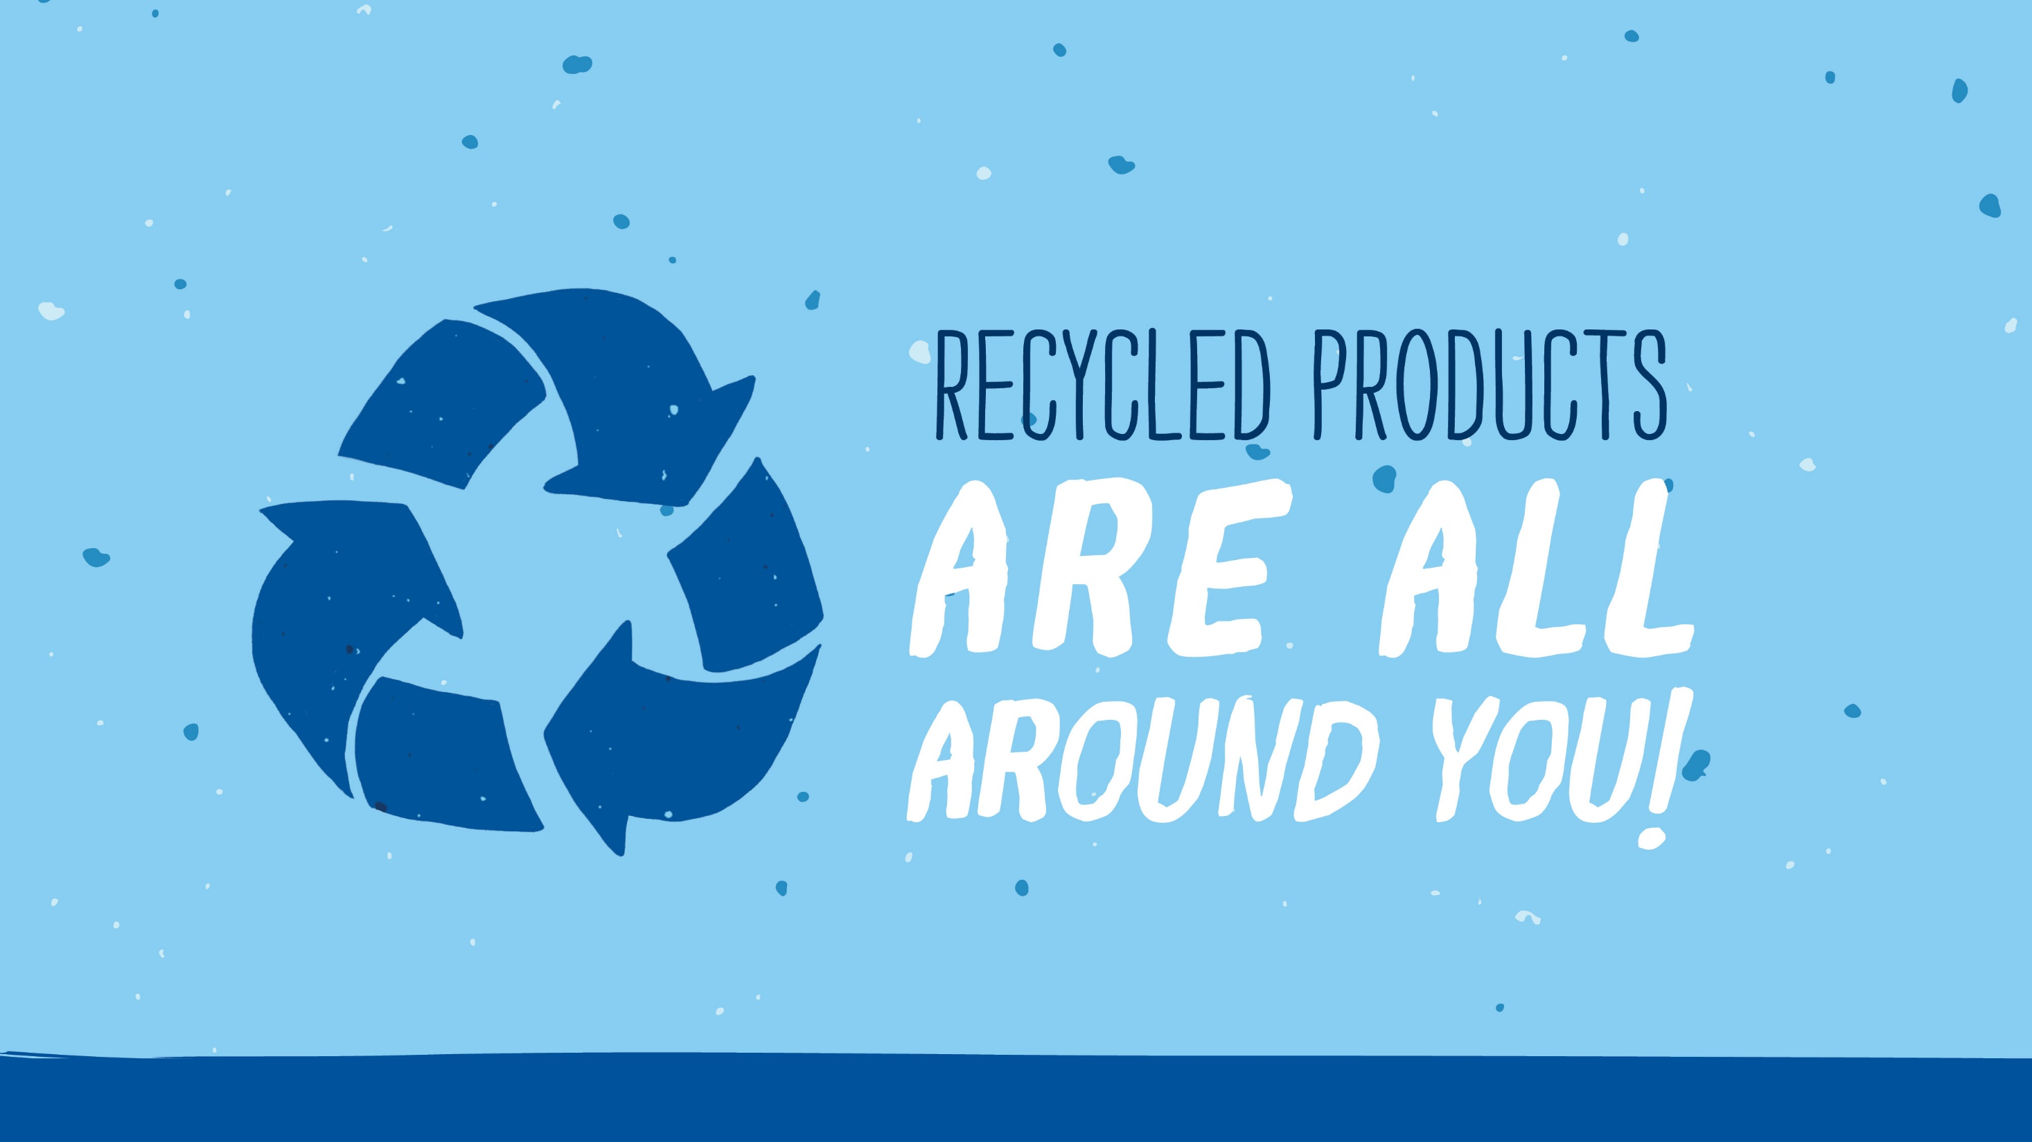
Notes:
Recycled products are all around you. Consider trying to use more materials that are made from recycled content. Many school supplies, such as pens and pencils, paper and binders can be made from recycled materials.
When you purchase new products, also think about whether they will be reusable or recyclable when you’re done with them. Many products are made from materials that you can easily recycle here at school or at home, like aluminum cans and plastic bottles.

Slide 25
Visit https://www.pepsicorecyclerally.com/
For more details and other useful recycling resources.

